Slide 1

Introduction to Technical Writing

Slide 2
Definition
Technical writing is a type of writing where the author is writing about a particular subject that requires direction, instruction, or explanation.

Slide 3
Goals
To deliver technical information for readers in a manner that is adapted to their needs, level of understanding, and background.
To communicate with specific audience, for a specific purpose.

Slide 4
Technical Writing
Technical writing is the presentation of information that helps the reader to solve a particular problem.
Technical writing is used in proposals, manuals, web pages, lab reports, newsletters, and many other kinds of professional documents.
Technical writing is used to communicate information to management, employees, and other businesses.
Technical writing can be considered the conduit between people who know technology and those who use it.

Slide 6
Technical Writing
Technical writing requires transparency of expression
and therefore a straightforward use of language.
Technical writing requires the recognition of the overall goal prior to beginning a document.
Writers must have knowledge of the intended audience.
Documents must include certain key concepts so the information can be easily understood by the intended readers.
Technical writing is solution based

Slide 7
Characteristics
Understanding what is the purpose and why you are writing.
To inform? To instruct? To propose?
To recommend? Or to persuade?

Slide 8
Characteristics
Writing for audience.
Who is the audience? What is their background?
What do they need?

Slide 9
Characteristics
Satisfying document specifications (Appropriate genre/type of document)
What is the document type?
How about the required format?

Slide 10
Characteristics
Providing accurate information.
Technical writing document is not about opinion.

Slide 11
Characteristics
Expressing information clearly.
No room for ambiguity!

Slide 12
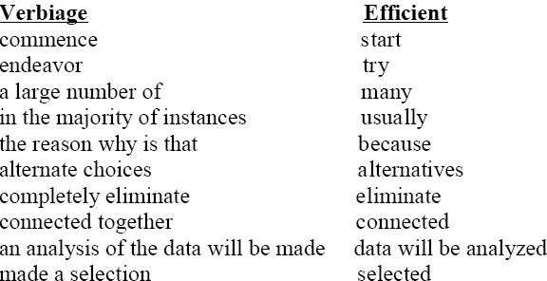
Characteristics
Using efficient words.

Slide 13
Characteristics
Using appropriate writing style and the right punctuation marks.
Be careful of typos, sentences in conversational tone, and punctuation problems!

Slide 14
Effective Technical Writing
Clarity
Conciseness
Accuracy
Organization
Process

Slide 15
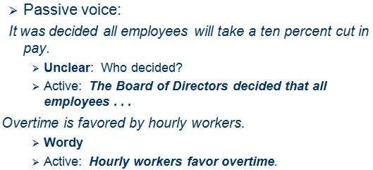
Clarity
Specify.
Avoid obscure words.
Limit and/or define your use of abbreviations, acronyms, and jargon.
Use the active versus the passive voice.

Slide 16

Conciseness
Limit paragraph, word, and sentence length.
Proofread for accuracy
Avoid redundancies

Slide 17
Accuracy
The importance of correct grammar.

Slide 18
Organization
Methods for organizing
Definition
Comparison/Contrast
More Important to Less Important
Situation-Problem-Solution-Evaluation
Cause-Effect

Slide 19
Process
All that you need to do is three things:
Prewrite
Write
Rewrite
(about 25 percent of your time) (about 25 percent of your time) (about 50 percent of your time)

Slide 20
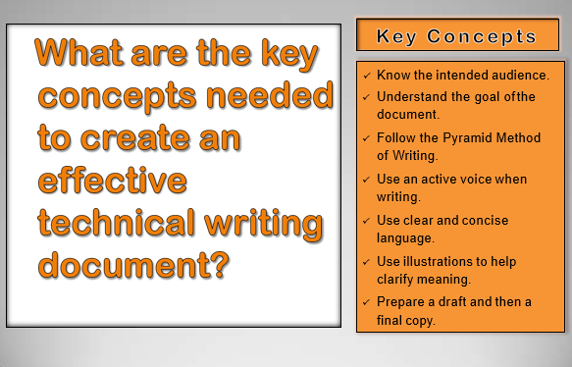

Slide 21


Slide 22
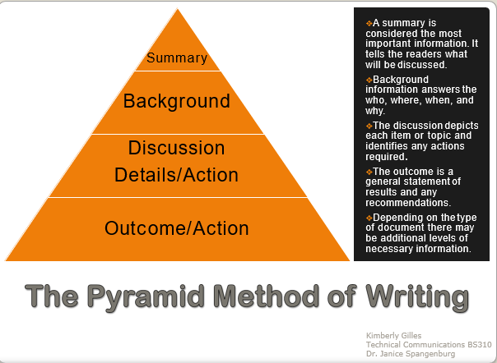

Slide 23
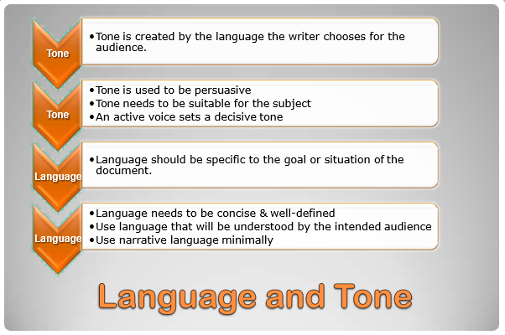

Slide 24
